Slide 1

Tunnelling SRT over QUIC Datagram
Maxim Sharabayko, PhD maxsharabayko@haivision.com

Slide 2

What is SRT?
Enabling low-latency video contribution & distribution and fast file transfer over unpredictable networks.
A sub-second latency live contribution protocol on top of UDP (unicast).
Stream multiplexing.
Bidirectional transmission.
Packet loss recovery (ARQ and/or FEC) within a fixed end-to-end latency constraint.
Content agnostic.
Multipath (experimental since v1.4.2).
Secure (PBKDF2 + AES 128/192/256 Encryption)
More info: SRT Protocol Overview (SVA 2020) https://www.youtube.com/watch?v=MFJeyInLKZY

Slide 3
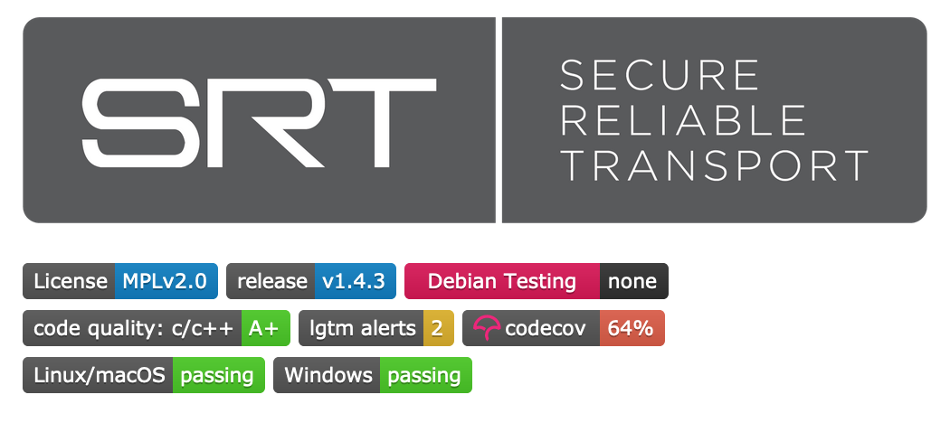
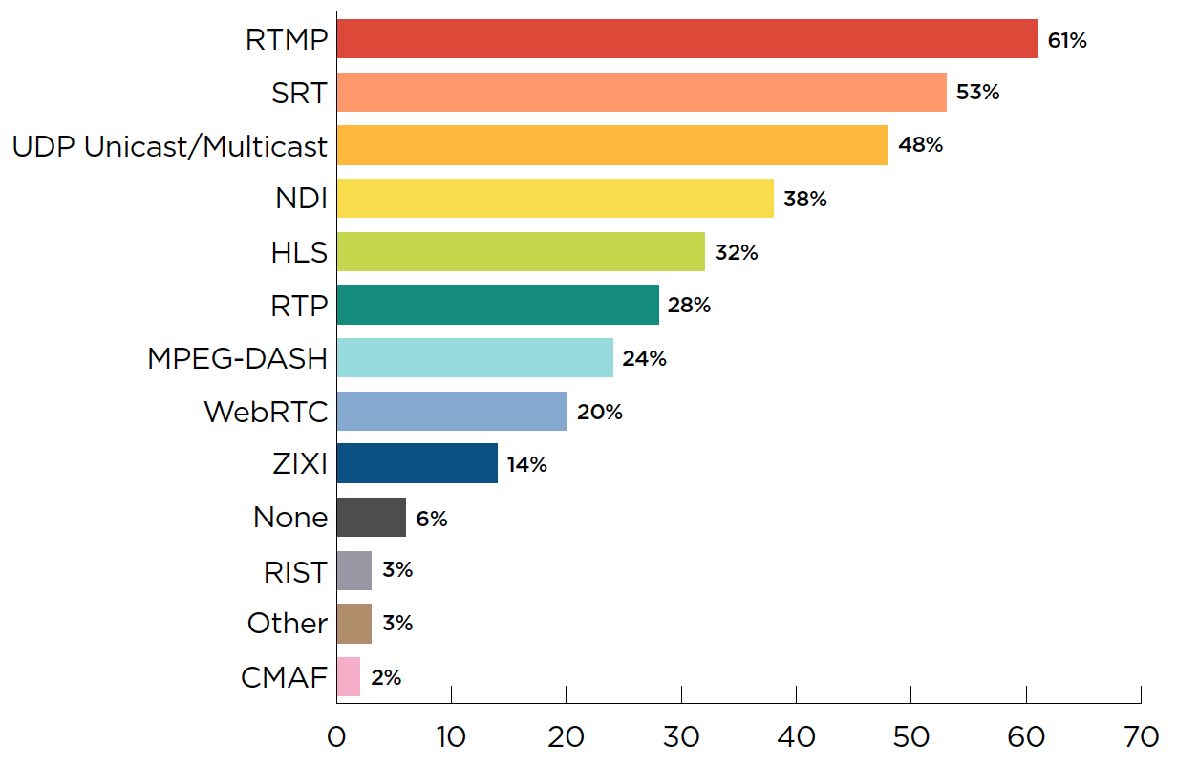

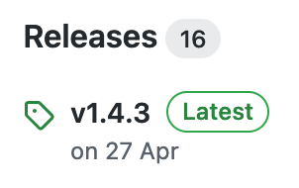

SRT is an Open-Source Library
* Haivision’s Broadcast IP Transformation Report 2021 Which video transport protocols do you currently use?
A multiple choice, multiple answer survey conducted
throughout November and December 2020among broadcasters worldwide (over 500 respondents
from more than 40 countries).

Slide 4
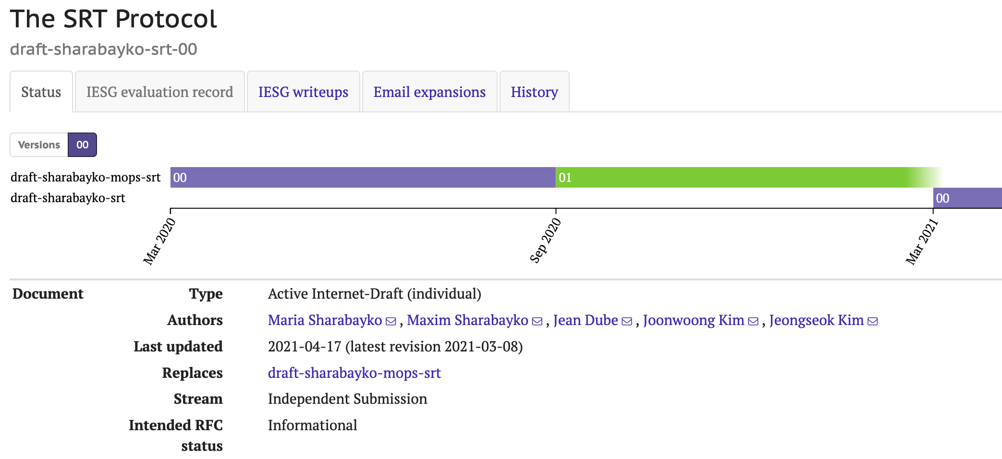
SRT RFC Draft
SRT RFC draft log:
1. Latest: draft-sharabayko-srt-00 2. draft-sharabayko-mops-srt v.01 3. draft-sharabayko-mops-srt v.00

Slide 5
What is QUIC?
RFC9000. QUIC: A UDP-Based Multiplexed and Secure Transport.
draft-ietf-quic-datagram-03: An Unreliable Datagram Extension to QUIC (Standards Track).
“When an application sends an unreliable datagram over a QUIC connection, QUIC will generate a new DATAGRAM frame and send it in the first available packet. This frame SHOULD be sent as soon as possible, and MAY be coalesced with other frames.”
“When a QUIC endpoint receives a valid DATAGRAM frame, it SHOULD deliver the data to the application immediately, as long as it is able to process the frame and can store the contents in memory.”
“DATAGRAM frames cannot be fragmented, therefore application protocols need to handle cases where the maximum datagram size is limited by other factors.”
“DATAGRAM frames belong to a QUIC connection as a whole, and are not strongly associated with any stream ID at the QUIC layer. However, it is expected that applications will want to differentiate between specific DATAGRAM frames by using identifiers, such as for logical flows of datagrams or to distinguish between different kinds of datagrams.”

Slide 6
SRT over QUIC DATAGRAM
QUIC
Is to be supported by most of the CDNs, portals, clouds, etc.
Adopters know how to handle, route and load balance QUIC traffic.
Confidence is TLS security level of QUIC.
Accessible from browsers (WebTransport).
SRT
Handle a sub-second latency live contribution and distribution.
A latency-aware packet loss recovery.
Stream multiplexing.
Access control (SRT Stream ID): resource name, operation mode (request, publish, …), type (file, stream, auth), etc.

Slide 7
Related Works
K. Pugin, A. Frindell, J. Cenzano, J. Weissman. RUSH - Reliable (unreliable) streaming protocol. draft-kpugin-rush-00
RTP over QUIC DATAGRAM
J. Ott, M. Engelbart. RTP over QUIC draft-engelbart-rtp-over-quic
S. Hurst. QRT: QUIC RTP Tunnelling draft-hurst-quic-rtp-tunnelling-01
J. Ott, R. Even, C. Perkins, V. Singh. RTP over QUIC draft-rtpfolks-quic-rtp-over-quic-01
Likely more to follow…

Slide 8
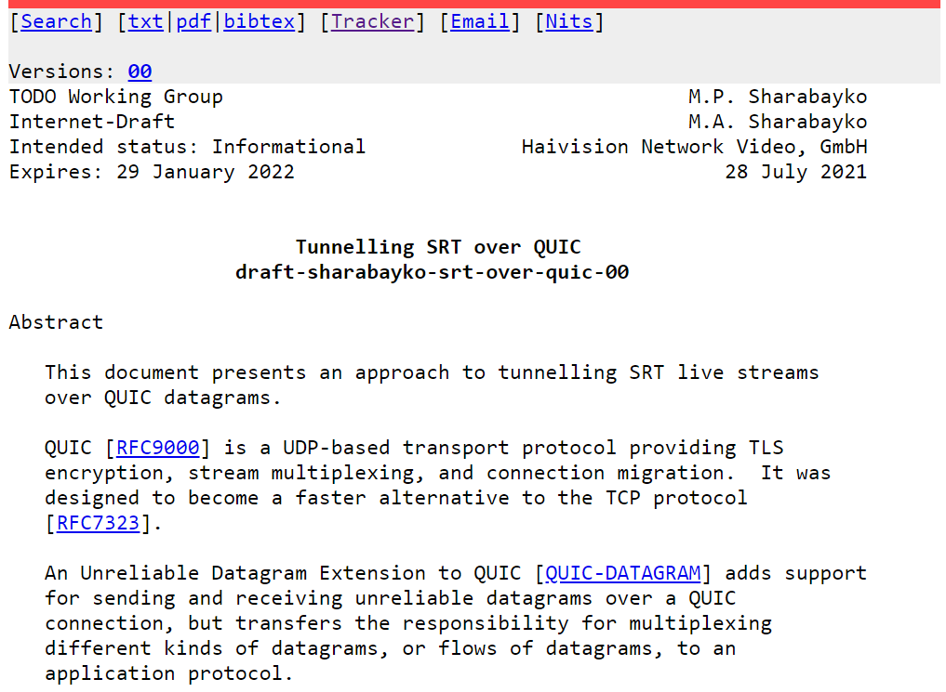
SRT over QUIC RFC Draft
Link: draft-sharabayko-srt-over-quic-00 (ietf.org)

Slide 9

SRT over QUIC PoC
quicly library from Fastly to provide a QUIC datagram transport.
Integrated into the srt-xtransmit app for testing (branch develop/quic). Live Transmission Commands
generate - dummy content streaming over SRT for performance tests
receive - receiving SRT streaming to null for performance tests
route - route packets between two sockets (UDP/SRT/QUIC) uni- or bidirectionally
srt-xtransmit metrics
end-to-end latency (transmission delay);
packet reordering (RFC 4737);
packet loss;
jitter (~RFC 3550).
Python scripts
lib-tcpdump-processing: a library to process tcpdump trace file and extract features for further analysis.
srt-stats-plotting: plot graphs out of SRT statistics.

Slide 10
Test Setup 1 (Sending over QUIC Datagram)
Local Switch 1 Gbps + Network Impairments
QUIC Client srt-xtransmit generate
QUIC
QUIC
QUIC Server srt-xtransmit receive
CentOS 7
Ubuntu 18.04.05 WSL

Slide 11
Test Setup 2 (Tunnelling SRT over QUIC Datagram)
Local Switch 1 Gbps + Network Impairments
QUIC Client srt-xtransmit route
QUIC
QUIC
QUIC Server srt-xtransmit route
UDP localhost
UDP localhost
SRT
SRT
SRT Sender, Caller srt-xtransmit generate
SRT Receiver, Listener srt-xtransmit receive
CentOS 7
Ubuntu 18.04.05 WSL

Slide 12
Test Results
RTT = 30 ms, SRT Latency = 120 ms (4xRTT), Sending Rate = 20 Mbps (20.6 on the wire), SRT payload 1128 bytes (6 MPEG-TS packets)
Sending over QUIC Datagram
Tunneling SRT over QUIC Datagram
Emulated Packet Loss, % | Actual Packet Loss, % * | Average Rate, Mbps **
0 | 0.42% | 21.3
1 | 1.49% | 21.2
3 | 3.41% | 21.3
5 | 5.11% | 21.2
10 | 9.97% | 21.4
Emulated Packet Loss, % | Actual Packet Loss, % | Average Rate, Mbps
0 | 0.00% | 21.6
1 | 0.00% | 21.9
3 | 0.00%*** | 22.5
5 | 0.00%*** | 23.1
10 | 0.05% | 24.9
* Actual Packet Loss = pktLost / (pktReceived + pktLost) as per srt-xtransmit metrics from the receiver side ** Average sending rate as per quicly statistics
*** 1-2 packets were lost during the whole experiment

Slide 13
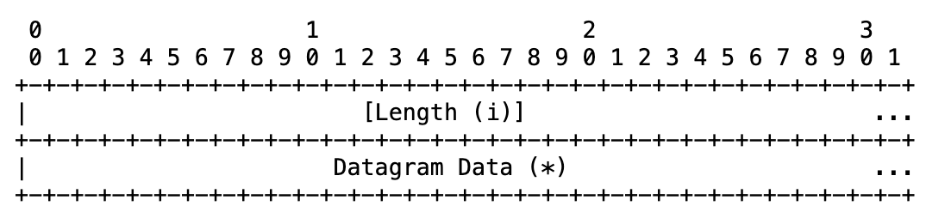
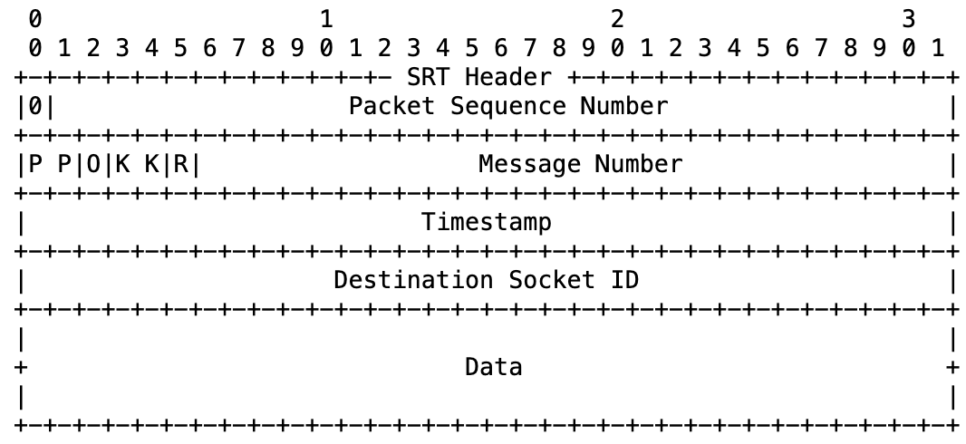
SRT Overhead
QUIC DATAGRAM frame:
SRT Data Packet:
16 bytes
e.g. 1128 bytes
Payload

Slide 14
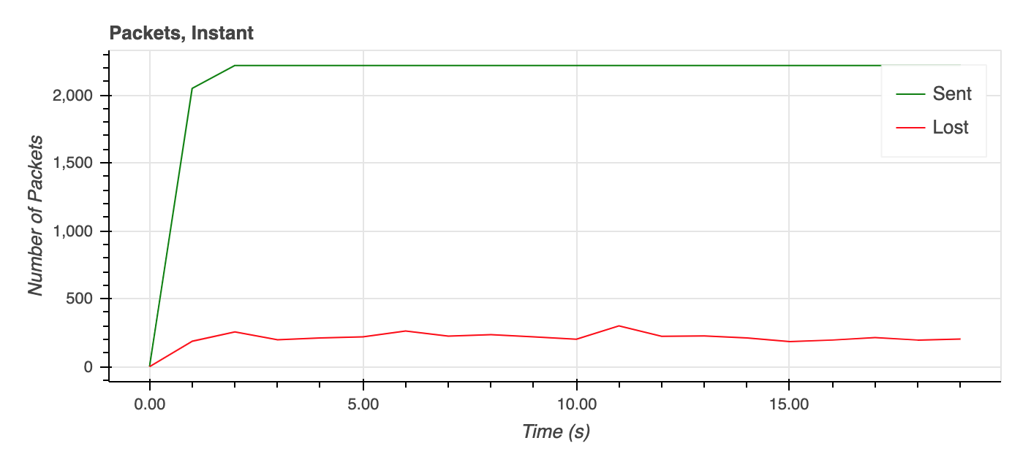
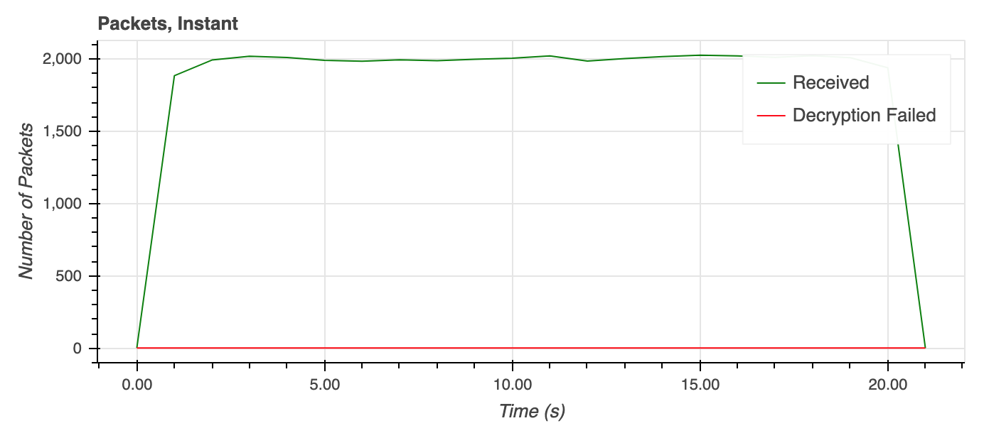
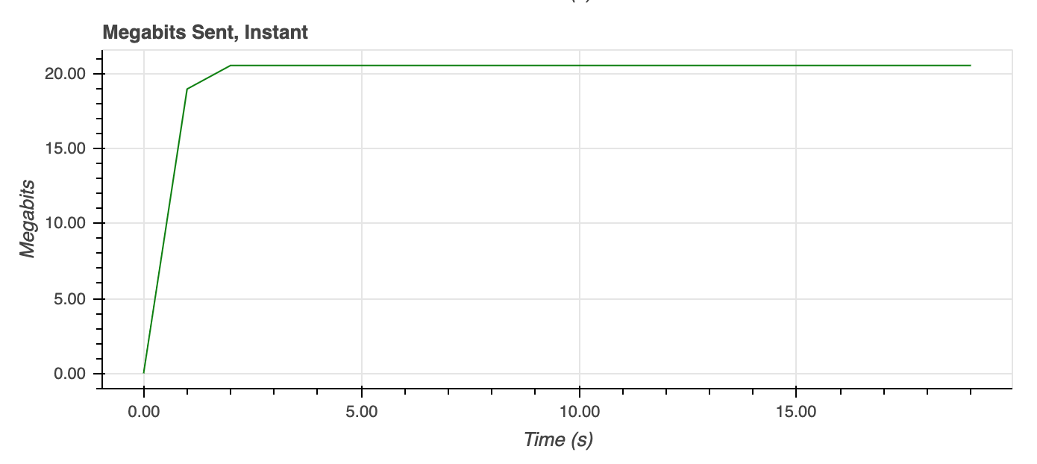
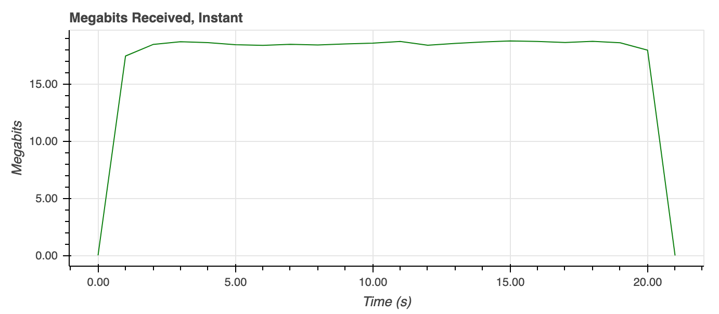
Sending over QUIC Datagram, Packet Loss = 10%
QUIC Client (Sender)
QUIC Server (Receiver)

Slide 15
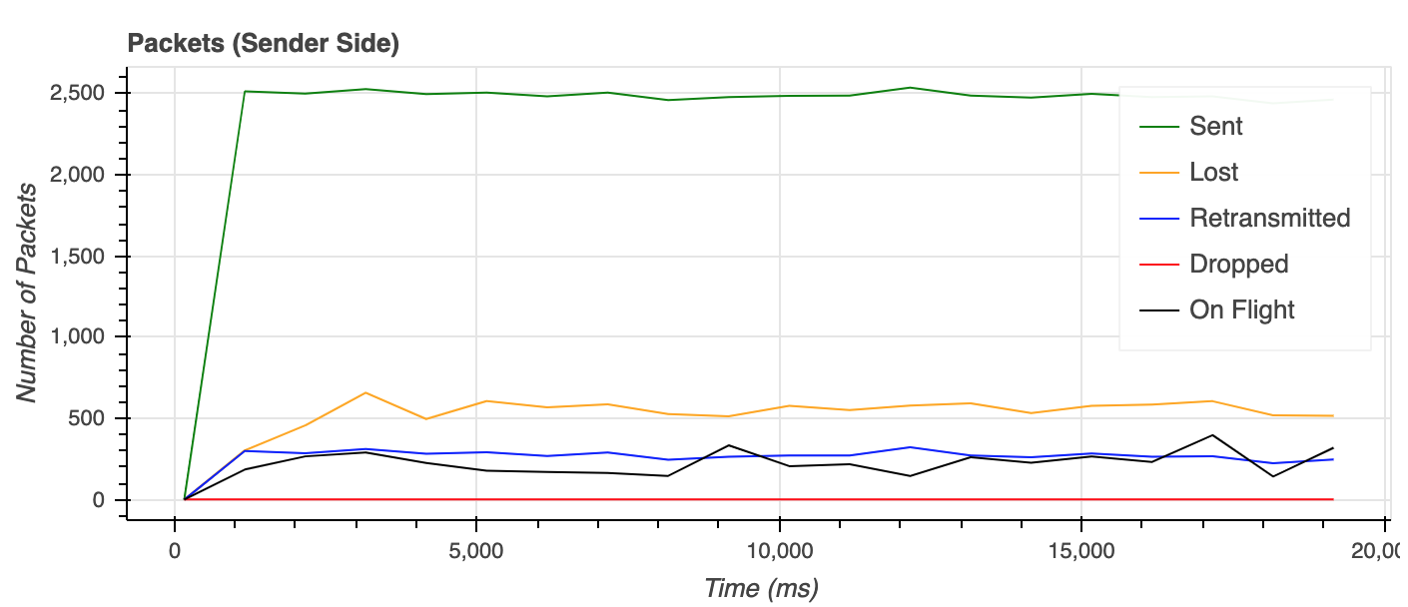
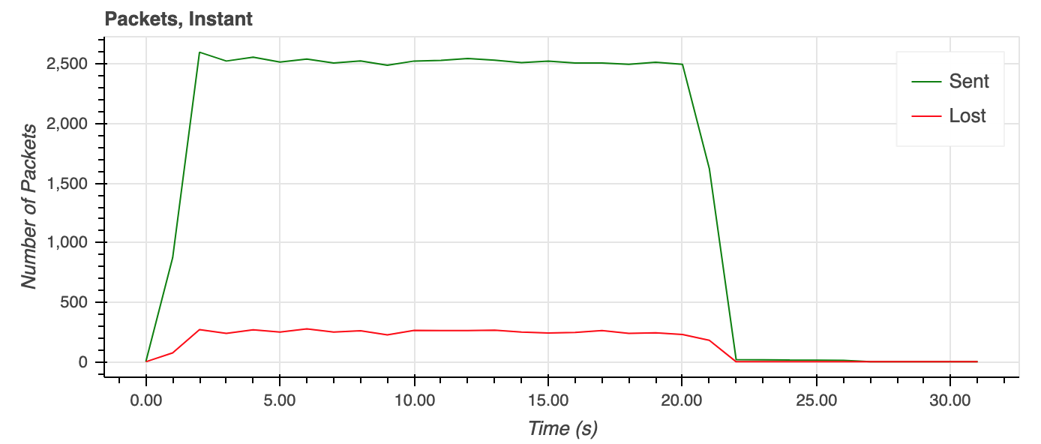
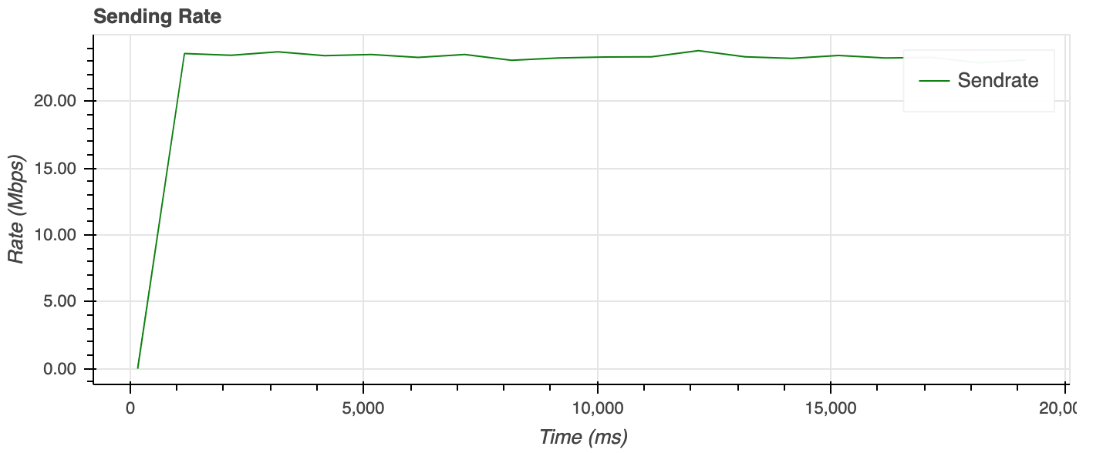
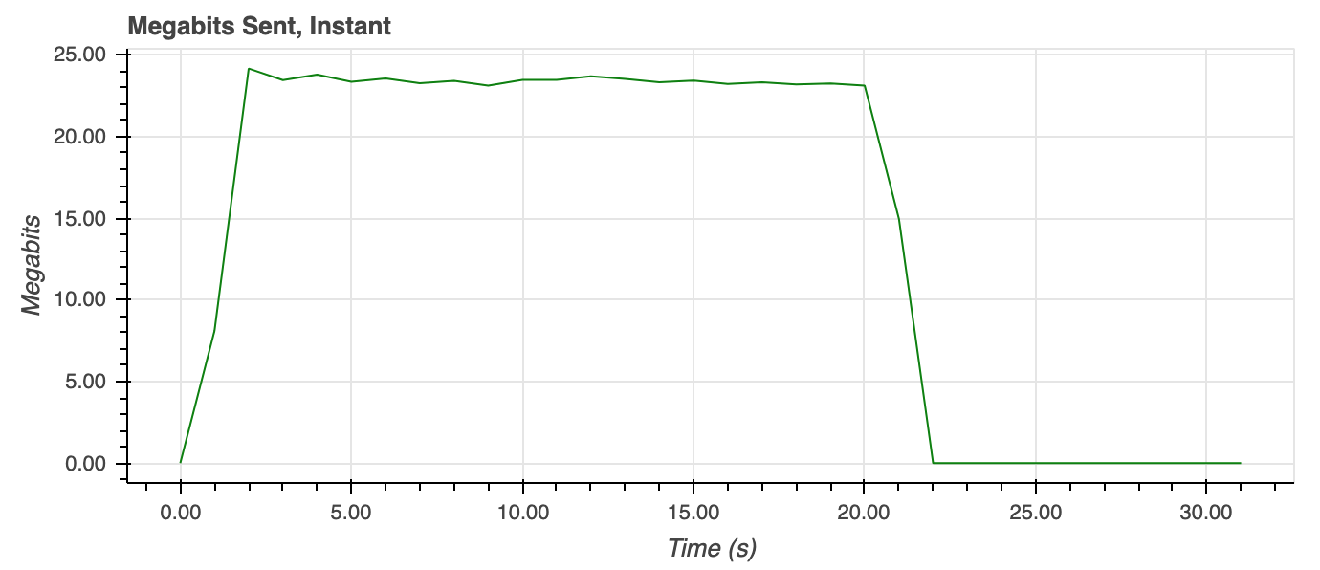
Tunnelling SRT over QUIC Datagram, Packet Loss = 10%, Sender Statistics
SRT Sender
QUIC Tunnelling Client (sending route)

Slide 16
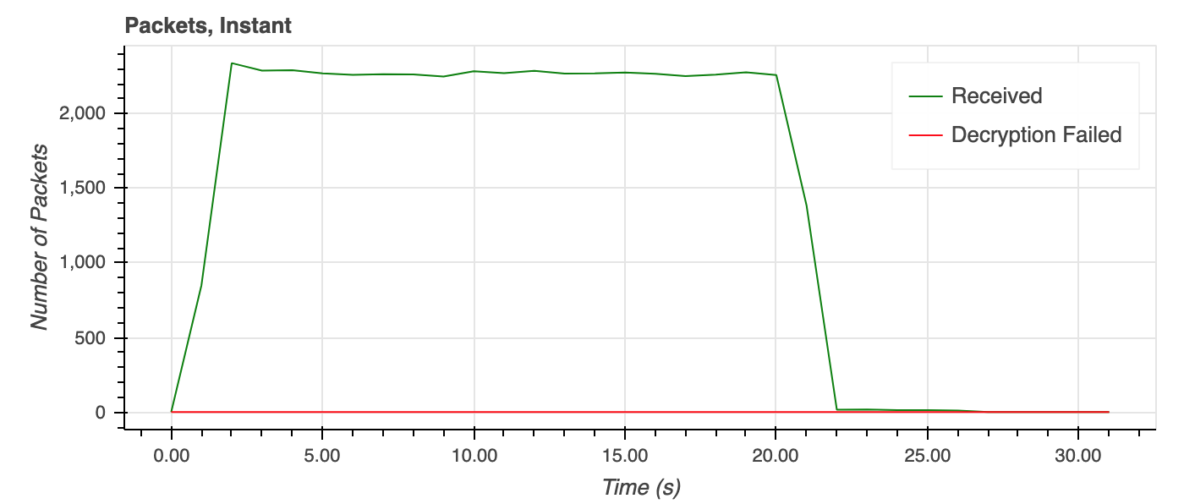
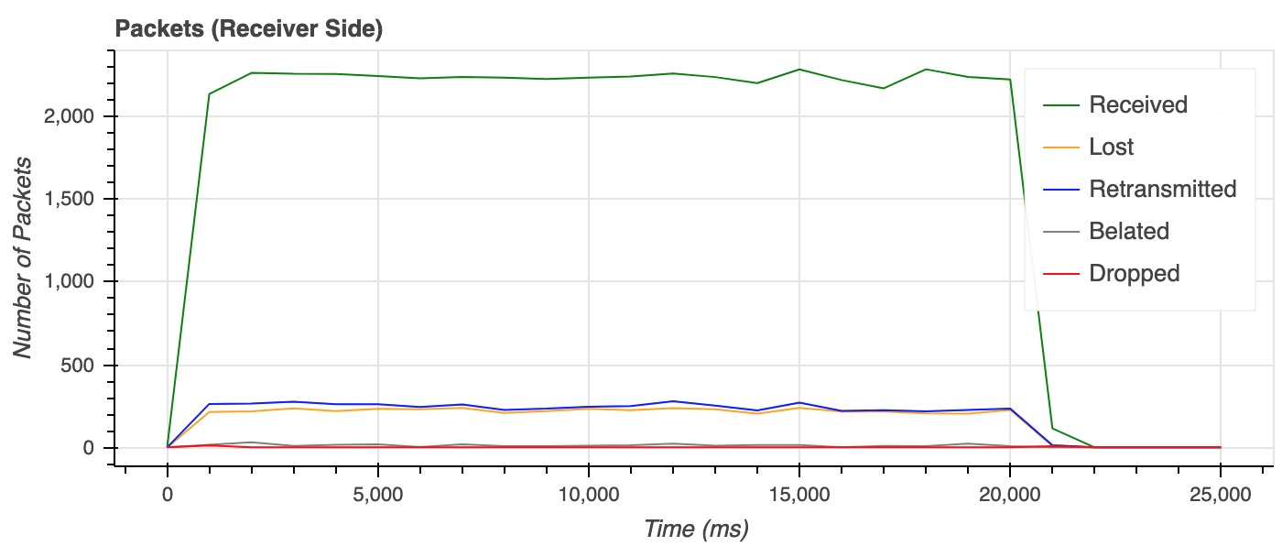
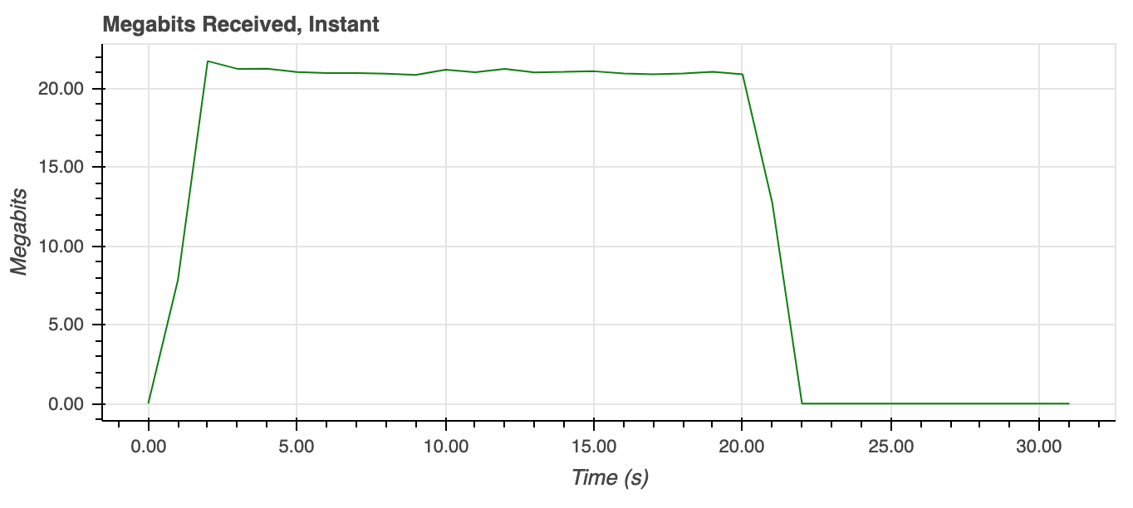
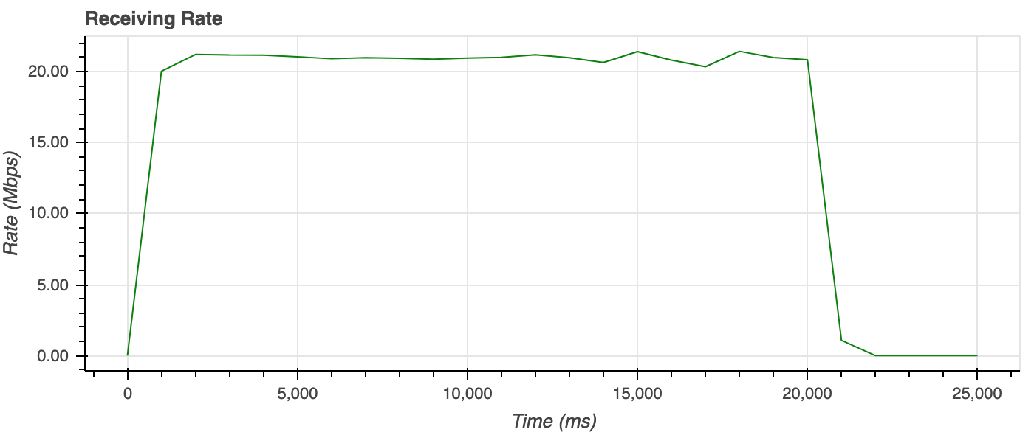
Tunnelling SRT over QUIC Datagram, Packet Loss = 10%, Receiver Statistics
QUIC Tunnelling Server (receiving route)
SRT Receiver

Slide 17
Further Steps
SRT over QUIC PoC
Address known issues
Live congestion control (SRT + QUIC)
Handling QUIC connection loss (reconnections)?
Integrate quicly in SRT library if there is enough interest in the use case.
IETF Activities
Target IETF working group to share results with?
Mailing list?
SRT over QUIC RFC draft, SRT RFC draft.

Slide 18




Contacts and References
https://srtalliance.slack.com Join: https://slackin-srtalliance.azurewebsites.net/ @Maxim Sharabayko
Get more info & share ideas:
SRT RFC Draft https://datatracker.ietf.org/doc/ draft-sharabayko-srt/
Tunnelling SRT over QUIC RFC Draft https://datatracker.ietf.org/doc/html/ draft-sharabayko-srt-over-quic
SRT Open-source Library https://github.com/Haivision/srt
SRT Alliance https://www.srtalliance.org/
SRT Slack Channel https://srtalliance.slack.com/ Channels: #quic-srt, #rfc
https://github.com/Haivision/srt @maxsharabayko
maxsharabayko@haivision.com
maxim-sharabayko

